Slide 1

Literature Survey
Cristian Noriega Monsalve, Blessing Austin-Gabriel, Ernest Chianumba, Rolih Ferdinand

Slide 2

Hybrid CNN-LSTM and Domain Modeling in Climate-Energy Analysis for a Smart Environment
Literature Review
GOAL
Predict net energy generation based on the temperature and identify interdependencies for smart cities
Correlation between power generation and temperature – local / state level
Hybrid approach CNN-LSTM, domain knowledge in Environmental Science
Python’s Sckit Learn is used for the implementation

Slide 3
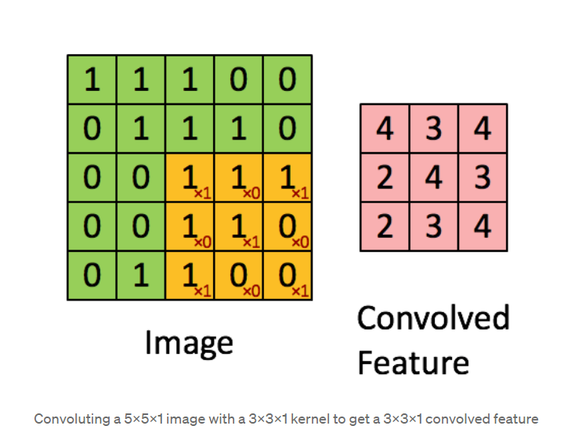
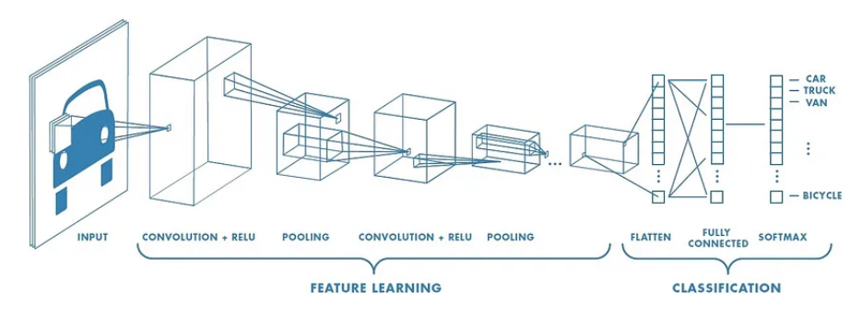
Convolutional Neural Networks (CNN)
Deep Learning algorithm that:
takes in an input image
assign importance (learnable weights and biases) to objects in the image
Identify features and predict them
CNN is used for image processing in object recognition

Slide 4
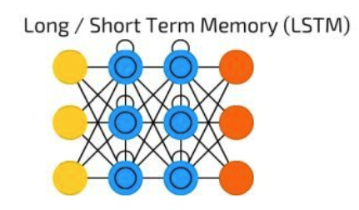
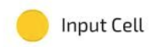


Long-Short Term Memory (LSTM)
Memory cell for storing Long-term information and gates (forget, input, and output)
Forecasting, analysis in time series and sequential data tasks (language processing, speech recognition, etc)

Slide 5
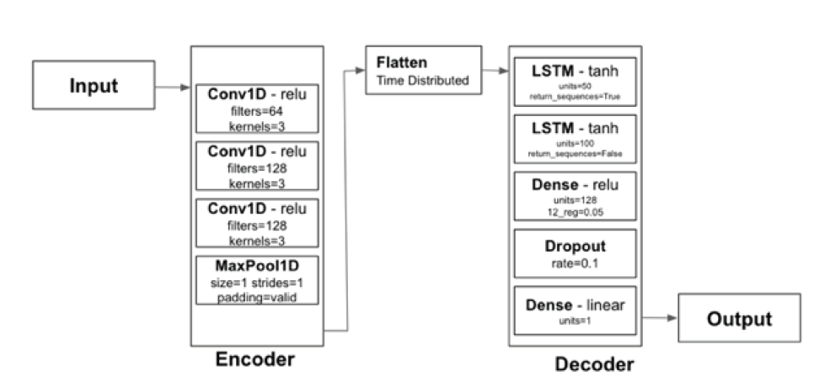
CNN-LSTM TO PREDICT NET ENERGY GENERATION FORECASTING
CNN: categorize weather conditions:
3 layers to analyze the data, then amplify its features
LSTM: learn solar power generation:
3 layers, uses learned weights to make complex decisions based on the extracted features

Slide 6
References
S. Shrestha, B. Buckley, A. S. Varde and D. Cwynar, "Hybrid CNN-LSTM and Domain Modeling in Climate-Energy Analysis for a Smart Environment," 2023 IEEE 35th International Conference on Tools with Artificial Intelligence (ICTAI), Atlanta, GA, USA, 2023, pp. 229-233, doi: 10.1109/ICTAI59109.2023.00041. keywords: {Climate change;Convolutional neural networks;Electricity;Long short term memory;Predictive models;Smart devices;Smart cities;Power generation;CNN;Climate Studies;Electricity;Energy;LSTM;Predictive Modeling;Smart Environment;Smart Cities},
https://towardsdatascience.com/a-comprehensive-guide-to-convolutional-neural-networks-the-eli5-way-3bd2b1164a53

Slide 7
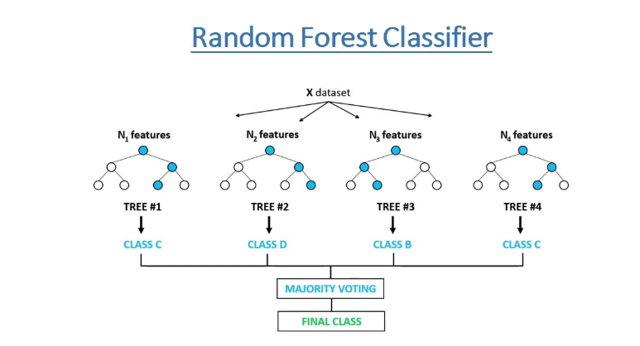
Leveraging Machine Learning for Diabetes Prediction
Literature Review
GOAL OF THE ANALYSIS
The paper utilizes the PIMA Indian Diabetes Dataset for its analysis. We delve into the effectiveness of the Random Forest algorithm, augmented by feature selection methods, to predict diabetes more accurately.
This dataset is a well-known resource in machine learning for diabetes research and consists of several medical predictor variables and one target variable, Outcome.
The predictors include the number of pregnancies, glucose concentration, blood pressure, skin thickness, insulin level, BMI, diabetes pedigree function, and age.
These parameters are used to predict whether a patient has diabetes (indicated by 1) or not (indicated by 0), based on diagnostic measurements.

Slide 8
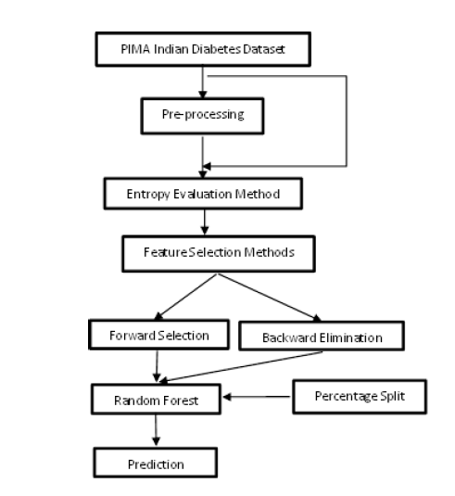
The Framework
Performance evaluation of the Random Forest algorithm across various feature subsets determined by the feature selection methods.
Identification of the feature subset that leads to the highest classification accuracy, demonstrating the efficacy of combining Random Forest with feature selection for diabetes prediction.
Implementation of entropy-based feature selection techniques, including:
Forward Selection: Iteratively adds features that improve model performance.
Backward Elimination: Iteratively removes the least significant features.
Forward selection iteratively adds features that enhance model performance, while backward elimination iteratively removes the least significant features.

Slide 9
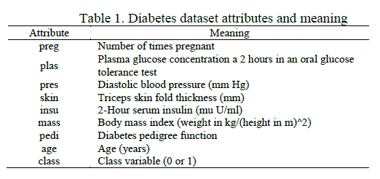
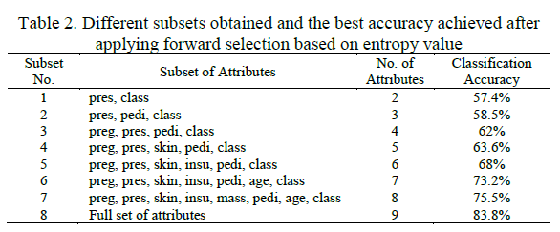
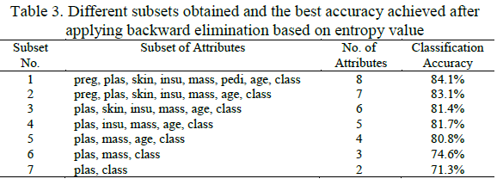
In this section, the paper presents the outcomes of the research work, which involves the application of data mining methods, specifically Random Forest, in conjunction with feature selection methods, such as forward selection and backward elimination, on the diabetes dataset.

Slide 10
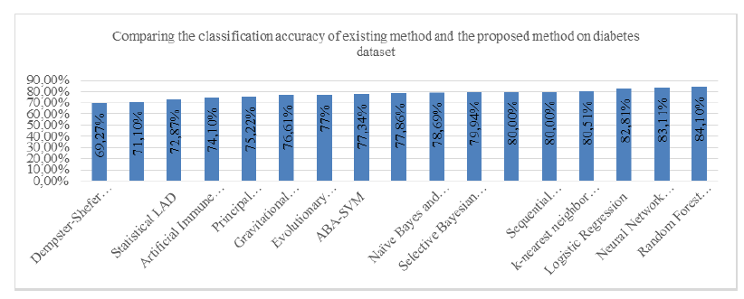
Results
Baseline Accuracy: The paper reports a baseline classification accuracy of 83.8% achieved using the full set of attributes in the diabetes dataset.
Feature Selection Impact: The study demonstrates a significant improvement in classification accuracy to 84.1% when employing feature selection methods, namely forward selection and backward elimination.
Key Attributes: This enhanced accuracy is achieved with only 7 specific attributes: "preg," "plas," "skin," "insu," "mass," "pedi," and "age." These attributes are found to be particularly influential in diabetes prediction.
A comparative analysis shows that the proposed approach outperforms other models or techniques applied to the same dataset. This visually reinforces the effectiveness of feature selection in enhancing diabetes prediction.

Slide 11
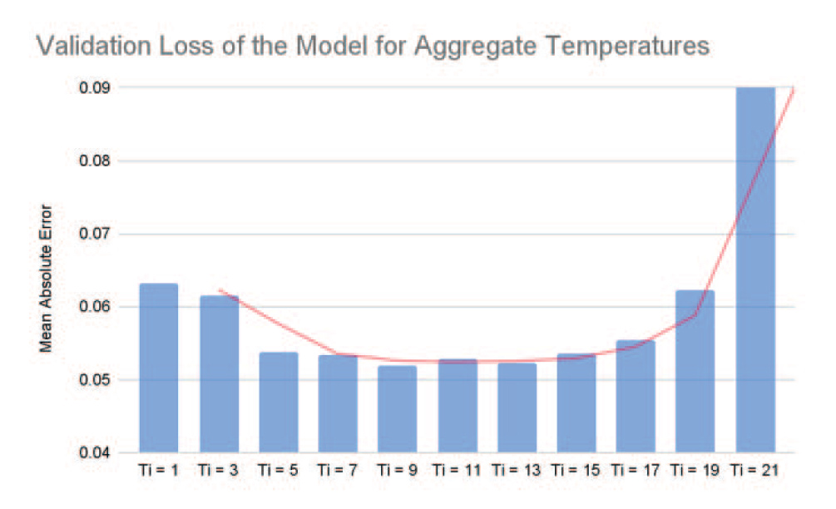
Smart Cities with AI
Machine Learning
CNN-LSTM diversification
9 to 13 temperature readings on the power plant have a better performance across the model
Real-time temperature allows dynamic adjustment in energy generation controlling greenhouse gas (GHG) emissions

Slide 12
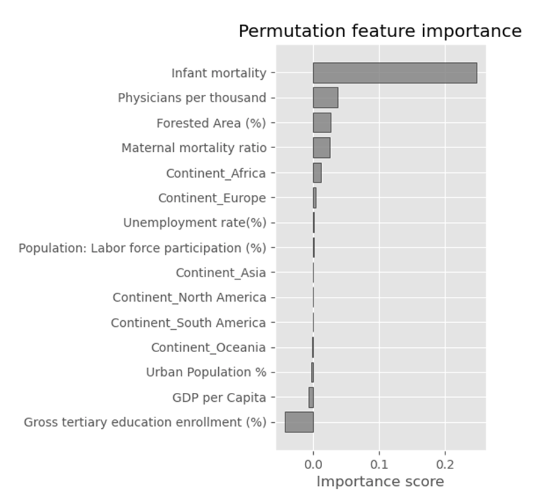
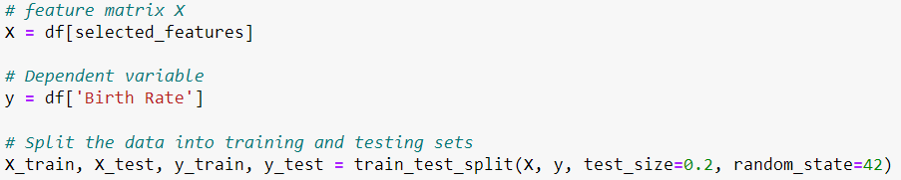
Picking the clusters and random state
The Elbow Method shows the number of clusters and the WCSS
I also choose the best random_state to allow for model reproduction. The silhouette score was around .28, .29

Slide 13
PAPER 1 Comparison of machine learning techniques used in type II diabetes risk prediction
By
kaluarachchi K.N., Premachandra K.P., Dissanayake R.B.N.

Slide 14
PAPER 1 Comparison of machine learning techniques used in type II diabetes risk prediction
By
kaluarachchi K.N., Premachandra K.P., Dissanayake R.B.N.

Slide 15
Objective
Compare Eight (8) Supervised Machine Learning models to identify the best algorithm with a low bias-variance trade-off for the diagnosis of Type II diabetes among female Native Americans living in America (PIMA)
Machine Learning models developed
Logistic Regression
Decision Tree
Random Forest
Support Vector Machine (SVM)
K-Nearest Neighbor (KNN)
Naïve Bayes
Gradient Boosting
Artificial Neural Network (ANN)
Data used
Native Americans living in Arizona (PIMA) Indians Diabetes Dataset, published by National Institute of Diabetes, Digestive & Kidney Diseases in the USA.

Slide 16
Basis on which the ML models were evaluated & compared (Indicators)
Testing Accuracy
Mean Square Error (MSE)
Precision
Rate of Recall (Sensitivity)
F1-score
Dataset and partitioning
768
Patient records
430
Training
Data
338
Testing
Data

Slide 17
Results
Random Forest (RF) has the highest Testing Accuracy – 83.12% & lowest MSE.
ANN achieved the highest MSE.
The results also shows that the most significant predictor variables are;
Number of pregnancies.
Insulin level
BMI level
Age
Conclusion
The RF with 50 subtrees is the most accurate ML model that can be used to diagnose Type II diabetes in the PIMA Indian Diabetes Dataset.

Slide 18
Paper 2 Comparative Research on Diabetes Influencing Factors Based on Random Forest and Decision Tree Models
By
Liping Li

Slide 19
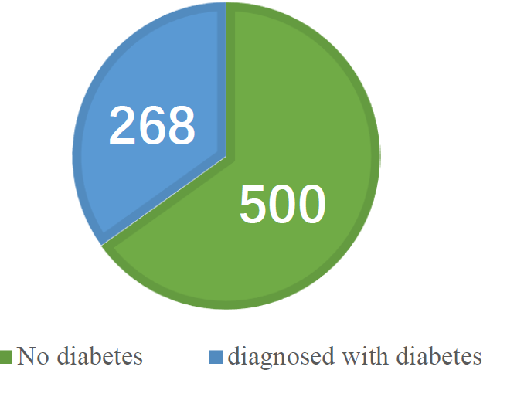
Objective
To forecast the influencing factors of cby comparing the results from Two (2) Machine Learning models;
Random Forest
Decision Trees
Data Source & Description
The data is derived from the PIMA Indian Dataset (PID) in the UCI dataset, which is mainly about the characteristic information of Pima Indian women over 21 years old. There are a total of 768 samples, including 9 characteristic variables, respectively 8 predictors and 1 label variable (label value 1 represents diabetes, label value 0 represents no diabetes).
According to the Target variable label value category statistics, there are 268 samples with a value of 1 (having diabetes) and 500 samples with a value of 0 (not having diabetes)
Dataset Features
Pregnancies | Blood glucose
Blood pressure | Serum insulin
Triceps skin thickness | Age
Body mass index | Diabetes pedigree function

Slide 20
Random Forest (RF) and Decision Trees (DT) were used to conduct a comparative study on the influencing factors of Diabetes with the aim to;
Enhance the performance of the forecast model
Increase the screening rate of Diabetes
Reduce the degree of the disease deterioration
Indicators evaluated
Testing Accuracy
Precision
F1-score
Rate of recall
Results
Random Forest (RF) has a higher F1-score – 79%.
Decision Trees (DT) achieved a lower F1-score – 72%.
The results also shows that the most significant predictor variables are;
Blood Glucose
Diabetes Pedigree function
BMI level
Age

Slide 21
Why Diabetes?
Of all the major non-communicable diseases to threaten human health, Diabetes ranks 3rd after Cardiovascular diseases & Cancer.
According to WHO, the costs associated with treating Diabetes are rising at an alarming rate, such that between 2005-2015, it led to an economic loss of $557.7 billion.
Diabetes comprises over 170 different types of complications.
According to International Diabetes Federation (IDF), 537 million people had diabetes in 2021, with 783 million anticipated to have it by 2045, approximately 10% of the world’s population.
China accounts for most Diabetes cases, with about 140 million, up from 90 million in the previous decade, a 56% rise.
Preventive measures and early diagnosis can help decrease this rising costs of treating Diabetes, and that is why using various methods to build models to analyze and predict this disease is of great importance.
There are a lot of previous work already done in this area using;
Logistic Regression
Naïve Bayes
Back Propagation Neural Network
Gradient Boosting
Random Forest etc.

Slide 22
Results & Discussion
Descriptive Statistics: Predictor Variables
Descriptive Statistics: Pearson Correlation Test

Slide 23
From the Pearson Correlation Test above, we see the strength of the correlation between the Target variable and the 8 predictors. We deduce that pregnancies (0.222), blood glucose (0.467), serum insulin (0.131), body mass index (0.293), diabetes pedigree function (0.174), and age (0.238) are reflecting an extremely positive correlation.
On the other hand, the correlation coefficient between Target and blood pressure, and triceps skin thickness was lower. It can be preliminarily learned that the variables of blood glucose, body mass index, age and pregnancies have more significant weights than other variables in predicting whether a sample has diabetes, and they can be recorded as influential factors that are more likely to cause the disease for prediction.
Furthermore, the correlation coefficient between variables show that age and pregnancies, are mostly correlated. Likewise serum insulin triceps skin thickness, body mass index & blood glucose, are all correlated.
Indicators evaluated
Testing Accuracy
Precision
F1-score
Rate of recall

Slide 24
Inferential Statistics: Feature weight values (Random Forest)
The feature weight of each variable illustrates how significant each variable is to the model, and the overall value is 1. It can be seen that blood glucose accounts for 24.83%, it gains the greatest weight and is crucial to the creation of models. For others; body mass index (16.13%), age (13.86%), diabetes pedigree function (12.16%) & pregnancies (8.99%).

Slide 25
Tables above represent the RF model's performance on the training set and the test set.
Rate of accuracy: The percentage of correct samples in the overall samples of the projected results.
= Number of Correct Predictions = 79.22%
Total Number of Predictions
Ratio of precision: The percentage of positive samples in the projected findings.
= True Positives = 78.96%
True Positives + False Positives
Rate of recall: The percentage of positive samples within the positive samples.
= True Positives = 79.22%
True Positives + False Negatives
F1-score is the comprehensive evaluation index of the precision ratio and recall rate, and is also the harmonic average of precision ratio and recall rate.
= 2 x Precision x Recall = 79.00%
Precision + Recall

Slide 26
Inferential Statistics: Feature weight values (Decision Tree)
The feature weight of each variable illustrates how significant each variable is to the model, and the overall value is 1. It can be seen that blood glucose accounts for 30.02%, it gains the greatest weight and is crucial to the creation of models. For others; body mass index (18.51%), age (14.77%), diabetes pedigree function (12.11%) & B.Pressure (10.24%).

Slide 27
Tables above represent the DT model's performance on the training set and the test set.
Rate of accuracy: The percentage of correct samples in the overall samples of the projected results.
= Number of Correct Predictions = 72.73%
Total Number of Predictions
Ratio of precision: The percentage of positive samples in the projected findings.
= True Positives = 72.19%
True Positives + False Positives
Rate of recall: The percentage of positive samples within the positive samples.
= True Positives = 72.73%
True Positives + False Negatives
F1-score is the comprehensive evaluation index of the precision ratio and recall rate, and is also the harmonic average of precision ratio and recall rate.
= 2 x Precision x Recall = 72.00%
Precision + Recall

Slide 28
Conclusion
PID dataset was used as the research data for this paper.
8 features, including pregnancies, blood glucose, blood pressure, triceps skin thickness, serum insulin, body mass index, diabetes pedigree function and age, were examined.
Target variable was whether diabetes was diagnosed or not.
The RF and DT algorithms were used to predict the data set, and the rate of accuracy, ratio of precision, rate of recall and F1-score ratio were utilized to analyze the model.
The results showed that the RF model was more suitable for predicting the data set, and this model had a stronger prediction ability than the DT model.
According to the analysis of influencing factors of diabetes in this dataset by RF model, the weight of four features such as blood glucose, body mass index, age and diabetes pedigree function accounted for the largest proportion.
Proposed actions
Elevated blood glucose should be focused on with timely medical examination and prevention.
Regarding Body mass index and age, obese people and elderly people should be vigilant.
Increase the awareness of diabetes prevention.
Pay attention to the balance of dietary structure and maintain good eating habits.
In general, this paper aims to provide support for the prevention and research of diabetes, and the several predictive variables.

Slide 29
PAPER 1 Comparison of machine learning techniques used in type II diabetes risk prediction
By
kaluarachchi K.N., Premachandra K.P., Dissanayake R.B.N.

Slide 30
Objective
Compare Eight (8) Supervised Machine Learning models to identify the best algorithm with a low bias-variance trade-off for the diagnosis of Type II diabetes among female Native Americans living in America (PIMA)
Machine Learning models developed
Logistic Regression
Decision Tree
Random Forest
Support Vector Machine (SVM)
K-Nearest Neighbor (KNN)
Naïve Bayes
Gradient Boosting
Artificial Neural Network (ANN)
Data used
Native Americans living in Arizona (PIMA) Indians Diabetes Dataset, published by National Institute of Diabetes, Digestive & Kidney Diseases in the USA.

Slide 31
Basis on which the ML models were evaluated & compared (Indicators)
Testing Accuracy
Mean Square Error (MSE)
Precision
Rate of Recall (Sensitivity)
F1-score
Dataset and partitioning
768
Patient records
430
Training
Data
338
Testing
Data

Slide 32
Results
Random Forest (RF) has the highest Testing Accuracy – 83.12% & lowest MSE.
ANN achieved the highest MSE.
The results also shows that the most significant predictor variables are;
Number of pregnancies.
Insulin level
BMI level
Age
Conclusion
The RF with 50 subtrees is the most accurate ML model that can be used to diagnose Type II diabetes in the PIMA Indian Diabetes Dataset.

Slide 33
Paper 2 Comparative Research on Diabetes Influencing Factors Based on Random Forest and Decision Tree Models
By
Liping Li

Slide 34
Objective
To forecast the influencing factors of cby comparing the results from Two (2) Machine Learning models;
Random Forest
Decision Trees
Data Source & Description
The data is derived from the PIMA Indian Dataset (PID) in the UCI dataset, which is mainly about the characteristic information of Pima Indian women over 21 years old. There are a total of 768 samples, including 9 characteristic variables, respectively 8 predictors and 1 label variable (label value 1 represents diabetes, label value 0 represents no diabetes).
According to the Target variable label value category statistics, there are 268 samples with a value of 1 (having diabetes) and 500 samples with a value of 0 (not having diabetes)
Dataset Features
Pregnancies | Blood glucose
Blood pressure | Serum insulin
Triceps skin thickness | Age
Body mass index | Diabetes pedigree function

Slide 35
Random Forest (RF) and Decision Trees (DT) were used to conduct a comparative study on the influencing factors of Diabetes with the aim to;
Enhance the performance of the forecast model
Increase the screening rate of Diabetes
Reduce the degree of the disease deterioration
Indicators evaluated
Testing Accuracy
Precision
F1-score
Rate of recall
Results
Random Forest (RF) has a higher F1-score – 79%.
Decision Trees (DT) achieved a lower F1-score – 72%.
The results also shows that the most significant predictor variables are;
Blood Glucose
Diabetes Pedigree function
BMI level
Age

Slide 36
Why Diabetes?
Of all the major non-communicable diseases to threaten human health, Diabetes ranks 3rd after Cardiovascular diseases & Cancer.
According to WHO, the costs associated with treating Diabetes are rising at an alarming rate, such that between 2005-2015, it led to an economic loss of $557.7 billion.
Diabetes comprises over 170 different types of complications.
According to International Diabetes Federation (IDF), 537 million people had diabetes in 2021, with 783 million anticipated to have it by 2045, approximately 10% of the world’s population.
China accounts for most Diabetes cases, with about 140 million, up from 90 million in the previous decade, a 56% rise.
Preventive measures and early diagnosis can help decrease this rising costs of treating Diabetes, and that is why using various methods to build models to analyze and predict this disease is of great importance.
There are a lot of previous work already done in this area using;
Logistic Regression
Naïve Bayes
Back Propagation Neural Network
Gradient Boosting
Random Forest etc.

Slide 37
Results & Discussion
Descriptive Statistics: Predictor Variables
Descriptive Statistics: Pearson Correlation Test

Slide 38
From the Pearson Correlation Test above, we see the strength of the correlation between the Target variable and the 8 predictors. We deduce that pregnancies (0.222), blood glucose (0.467), serum insulin (0.131), body mass index (0.293), diabetes pedigree function (0.174), and age (0.238) are reflecting an extremely positive correlation.
On the other hand, the correlation coefficient between Target and blood pressure, and triceps skin thickness was lower. It can be preliminarily learned that the variables of blood glucose, body mass index, age and pregnancies have more significant weights than other variables in predicting whether a sample has diabetes, and they can be recorded as influential factors that are more likely to cause the disease for prediction.
Furthermore, the correlation coefficient between variables show that age and pregnancies, are mostly correlated. Likewise serum insulin triceps skin thickness, body mass index & blood glucose, are all correlated.
Indicators evaluated
Testing Accuracy
Precision
F1-score
Rate of recall

Slide 39
Inferential Statistics: Feature weight values (Random Forest)
The feature weight of each variable illustrates how significant each variable is to the model, and the overall value is 1. It can be seen that blood glucose accounts for 24.83%, it gains the greatest weight and is crucial to the creation of models. For others; body mass index (16.13%), age (13.86%), diabetes pedigree function (12.16%) & pregnancies (8.99%).

Slide 40
Tables above represent the RF model's performance on the training set and the test set.
Rate of accuracy: The percentage of correct samples in the overall samples of the projected results.
= Number of Correct Predictions = 79.22%
Total Number of Predictions
Ratio of precision: The percentage of positive samples in the projected findings.
= True Positives = 78.96%
True Positives + False Positives
Rate of recall: The percentage of positive samples within the positive samples.
= True Positives = 79.22%
True Positives + False Negatives
F1-score is the comprehensive evaluation index of the precision ratio and recall rate, and is also the harmonic average of precision ratio and recall rate.
= 2 x Precision x Recall = 79.00%
Precision + Recall

Slide 41
Inferential Statistics: Feature weight values (Decision Tree)
The feature weight of each variable illustrates how significant each variable is to the model, and the overall value is 1. It can be seen that blood glucose accounts for 30.02%, it gains the greatest weight and is crucial to the creation of models. For others; body mass index (18.51%), age (14.77%), diabetes pedigree function (12.11%) & B.Pressure (10.24%).

Slide 42
Tables above represent the DT model's performance on the training set and the test set.
Rate of accuracy: The percentage of correct samples in the overall samples of the projected results.
= Number of Correct Predictions = 72.73%
Total Number of Predictions
Ratio of precision: The percentage of positive samples in the projected findings.
= True Positives = 72.19%
True Positives + False Positives
Rate of recall: The percentage of positive samples within the positive samples.
= True Positives = 72.73%
True Positives + False Negatives
F1-score is the comprehensive evaluation index of the precision ratio and recall rate, and is also the harmonic average of precision ratio and recall rate.
= 2 x Precision x Recall = 72.00%
Precision + Recall

Slide 43
Conclusion
PID dataset was used as the research data for this paper.
8 features, including pregnancies, blood glucose, blood pressure, triceps skin thickness, serum insulin, body mass index, diabetes pedigree function and age, were examined.
Target variable was whether diabetes was diagnosed or not.
The RF and DT algorithms were used to predict the data set, and the rate of accuracy, ratio of precision, rate of recall and F1-score ratio were utilized to analyze the model.
The results showed that the RF model was more suitable for predicting the data set, and this model had a stronger prediction ability than the DT model.
According to the analysis of influencing factors of diabetes in this dataset by RF model, the weight of four features such as blood glucose, body mass index, age and diabetes pedigree function accounted for the largest proportion.
Proposed actions
Elevated blood glucose should be focused on with timely medical examination and prevention.
Regarding Body mass index and age, obese people and elderly people should be vigilant.
Increase the awareness of diabetes prevention.
Pay attention to the balance of dietary structure and maintain good eating habits.
In general, this paper aims to provide support for the prevention and research of diabetes, and the several predictive variables.

Slide 44
Machine Learning & Geospatial Techniques in Building Energy Performance Prediction

Slide 45
Introduction
The study introduces an innovative approach for GIS-based residential building energy performance prediction at multi-scale using a data-driven machine learning approach
It demonstrates the methodology for the Irish residential building stock to evaluate the energy rating at multiple scales.
It aims to aid urban planners in reducing energy consumption and CO2 emissions, crucial for sustainable urban development.

Slide 46
Machine Learning Techniques
The paper uses various machine learning algorithms like Naive Bayes, GLM, Random Forest, Decision Tree, Deep Learning, Logistic Regression, Gradient Boosted Trees, and SVM.
The machine-learning algorithm predicts building energy ratings from local to national scale using a bottom-up approach.

Slide 47
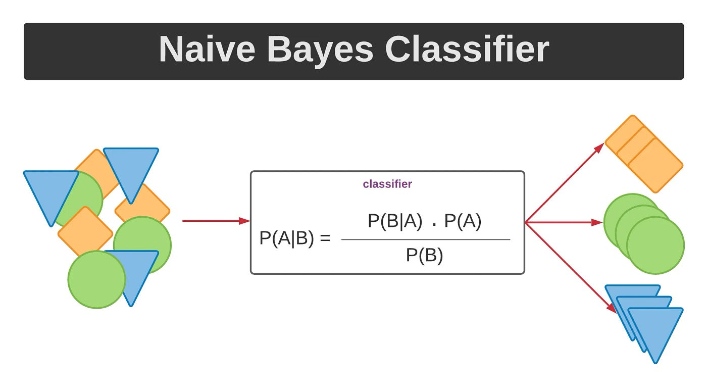
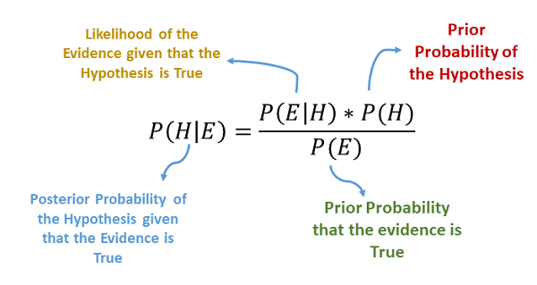
Naive Bayes (NB)
Naive Bayes (NB) is a probabilistic classifier applying Bayes' theorem with independence assumptions between features.
Known for simplicity and effectiveness in text classification.
Could be used for classifying areas based on pollution levels or climate risk categories.
Due to its effectiveness in text classification, it could also be used to analyze textual data, like public opinions or policies regarding urban sustainability.

Slide 48
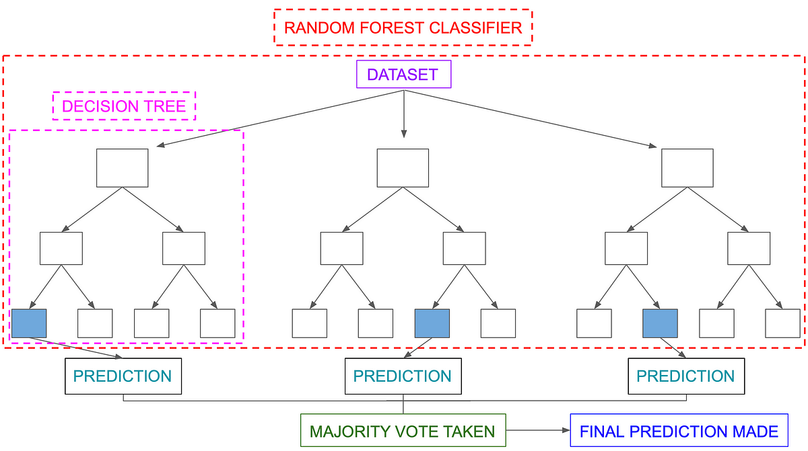
Random Forest (RF) / Decision Trees (DT)
Random Forest (RF) is an ensemble method using multiple decision trees for classification and regression. It combines the outcomes of individual trees for a robust prediction.
Decision Tree (DT) is a flowchart-like structure for classification, with nodes representing tests, branches for outcomes, and leaves for class labels.
These could be employed for predicting air quality and identifying key factors that influence pollution levels. Due to their ability to handle complex, nonlinear data, they could model the interactions between various environmental factors.

Slide 49
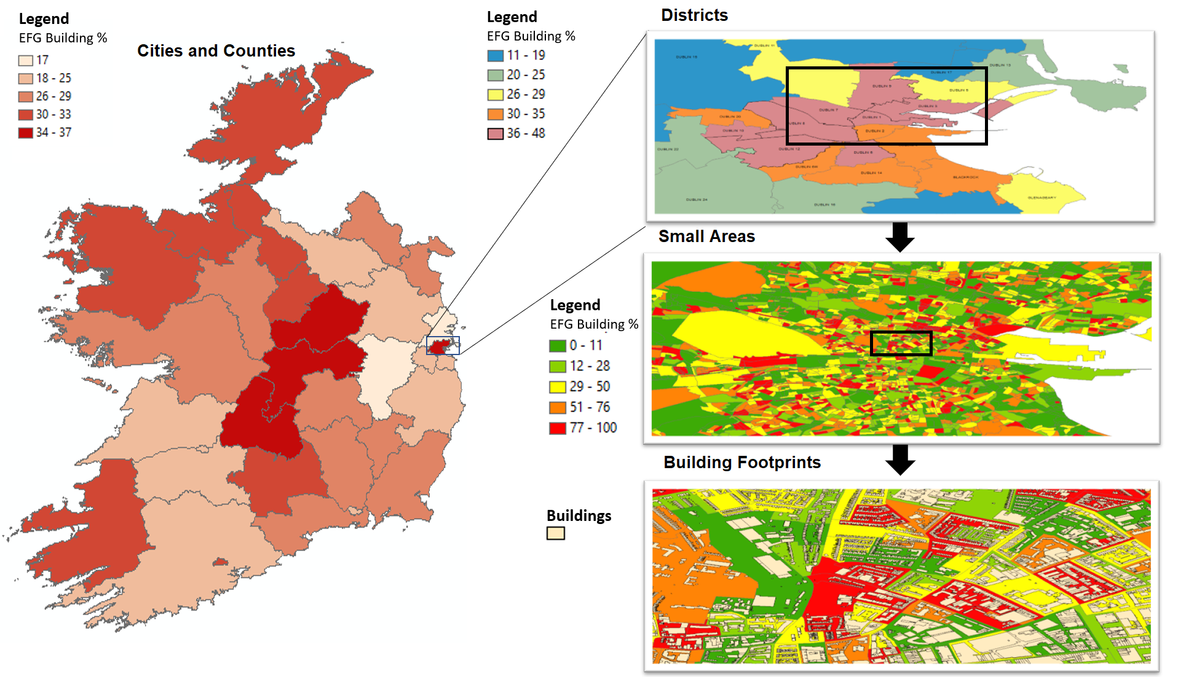
Geospatial Techniques
Key GIS techniques included spatial join/aggregation, multi-scale GIS mapping, and the use of LOF algorithm for outlier detection.
The multi-scale mapping process integrates the predictive modeling results with GIS.

Slide 50
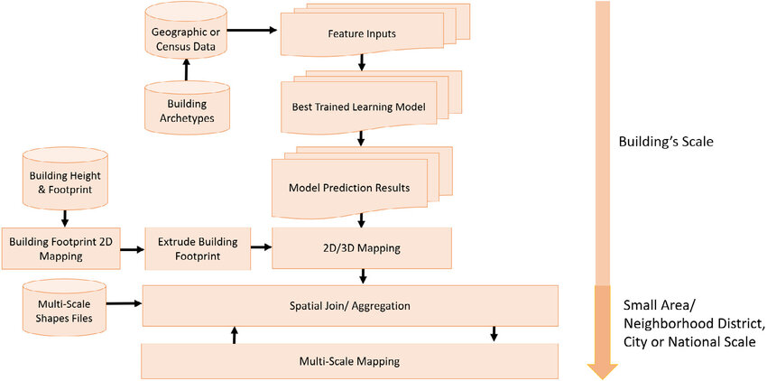
Multi-Scale GIS Mapping
Multi-Scale GIS Mapping includes data collection, prediction model development, GIS mapping, and energy planning. It offers a layered understanding of energy performance.
This technique could help in understanding how climate change and air pollution impact different scales, from local neighborhoods to entire cities, aiding in targeted policy-making.

Slide 51
Results
Results showed classification accuracy improvements in energy performance categories (A, B, CD, EFG).
Highest accuracy was 72% for year of construction, 67% for building type, and 69% for fuel type.
This method effectively identifies buildings with poor energy performance.

Slide 52

Conclusion
This study is pivotal for energy planning, offering a scalable, data-driven approach to identify areas for energy savings.
It's a step forward in utilizing technology for sustainable urban development and energy-efficient building management.

